Slide 1
Software for Digital Innovation (CIS4044-N)
Lecture 7
Python and SQLite3 Part 2

Slide 2
But first... Quick SQLite recap
For those who need it.

Slide 3
Databases
A database is an organised collection of structured data
Most commonly arranged into a series of related tables
This approach can be more efficient and effective than many alternative approaches
A large number of database management systems are available – we will be using SQLite3 in this module.

Slide 4
Benefits of SQLite3
Relational Database features without the hassle of managing a server – it is file-based
It is portable – it is file-based, allowing you to move the database around easily
Developing and testing applications requiring relational database is much easier – all data and files are local

Slide 5
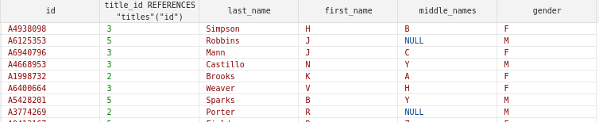
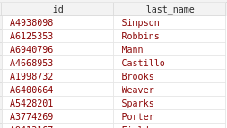
SELECT
SELECT is a SQL statement to retrieve data from a table or tables
* mean select all columns from the named table(s)
We can specify specific columns that we want to include only
SELECT *
FROM [students]
SELECT id, last_name
FROM [students]

Slide 6


WHERE clause
We can filter data based on some criteria – boolean operations similar to Python's
LIKE allows full or partial matches on text, the % is a wildcard, matching anything after A26
Similarities to Python’s in operator:
SELECT id, last_name
FROM [students]
WHERE id LIKE "A26%"
SELECT id, last_name
FROM [students]
WHERE last_name = "Tanner"
if "even" in "Steven":
# ... do something ...

Slide 7

WHERE clauses with AND & OR
We can filter data based on some criteria – logical operators
AND all conditions must match
OR any of the conditions must match
Like Python, precedence rules apply AND > OR where there are conditional expressions in the same statement
SELECT id, last_name
FROM [students]
WHERE last_name = "Tanner" OR id LIKE "%324%"
SELECT *
FROM [students]
WHERE last_name = "Tanner"
AND first_name = "M"

Slide 8
Python and SQL - Connection
Opening an SQLite connection in Python is done through the sqlite3.connect(…) function
Pass in the database file as the argument (usual filepath rules apply)
As the connection will be a live (and very expensive) resource, you should use with keyword
If the database doesn't exist when opening a connection, this will also create it!
import sqlite3
with sqlite3.connect("example.db") as conn:
cursor = conn.cursor()
# Database queries and operations...
conn.commit()

Slide 9
Python and SQL - Cursor
Once a connection is open, we need to create a cursor to read and manipulate our database
This is achieved through using the .cursor() function of the open connection
All the operations we will apply to our database will be executed through this cursor
import sqlite3
with sqlite3.connect("example.db") as conn:
cursor = conn.cursor()
# Database queries and operations...
conn.commit()

Slide 10
Basic Python/SQL pattern
Connect to the database
with sqlite3.connect("../db/CIS4044-N-Example.db") as conn:
conn.row_factory = sqlite3.Row # Use row column names
cursor = conn.cursor()
query = '''
SELECT id, last_name, first_name
FROM [students]
WHERE last_name = "Tanner" AND first_name = "M"
'''
results = cursor.execute(query) conn.commit()
for row in results:
print(row['id'], row['last_name'], row['first_name'])
Build a query string
Execute the query
Process the results

Slide 11
Learning objectives
SQLite3 database with multiple tables
Python
Introduce INNER JOIN with 2 tables
Avoid duplication of data
INNER JOIN with 3 tables
Use the AVG aggregate function and GROUP BY clause
Doing something with the data returned
Demonstrate calculating average in both Python and SQL
ICA discussion

Slide 12
Demo: People and their Titles
In a single table...

Slide 13
Bad data
There are a limited number of titles
The list to the right are some of the most common
The user entering the data was supposed to enter one of these
Problems
Duplication of data
Inconsistent data
Just plain wrong data
Mr.
Mrs.
Miss
Dr.
Ms.
Prof.
Rev.
Lady
Sir
Capt.
Major
Lt.-Col.
Col.
Lady
Lt.-Cmdr.
The Hon.
Cmdr.
Flt. Lt.
Brgdr.
Judge
Lord
The Hon. Mrs
Wng. Cmdr.
Group Capt.
Rt. Hon. Lord
Revd. Father
Revd Canon
Maj.-Gen.
Air Cdre.
Viscount
Dame
Rear Admrl.
Demo

Slide 14
JOIN Introduction
Student – Title Example

Slide 15
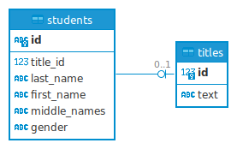
Titles Table
Separate titles into its own table
Relational Database terminology: Normalisation
Essentially, avoid duplication and redundancy where possible
The table is loaded with all the titles
In the left table (students) is made to an entry in the right table (titles)
A relation
When getting the student and their title, we need to involve two tables
We JOIN them on their relation (title_id, id)
ERD for Student and Titles

Slide 16
Foreign Keys
A Foreign Key (FK) is a reference to a unique row in another table
For example, the student table has a column called title_id which refers a single, unique entry in the titles table
Many students will have the same title_id (i.e. there are many Ms, Mr, etc), but those words appear only once in the titles table
title_id in students is a Foreign Key that references the Primary Key in the titles table
Outside the scope of the module, but we can add foreign key constraints so that attempts to delete what the FK references can be handled, for example preventing the deletion to ensure data integrity

Slide 17
INNER JOIN Clause
Probably the most common type of join
We join two tables on a shared value for each row
Here, we are using the title_id value stored in the students table to find its corresponding row by its id in the titles table
title_id is said to be a Foreign Key (FK) as it is used to refer to a single row in a foreign table (titles)
SELECT
s.id,
t.text as title,
s.first_name,
s.last_name
FROM
[students] AS s
INNER JOIN
[titles] AS t
ON
s.title_id = t.id
What columns to include from each table.
Note Giving the title text field another name
Table to JOIN to
Criteria for inclusion in the results

Slide 18
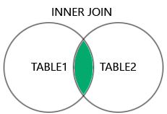
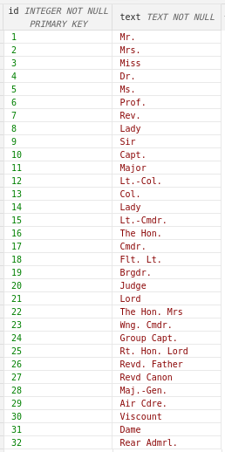
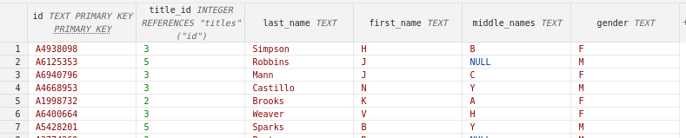
INNER JOIN
All rows from both tables that satisfy the ON condition
Inner Join image source:
https://www.w3schools.com/sql/sql_join_inner.asp

Slide 19
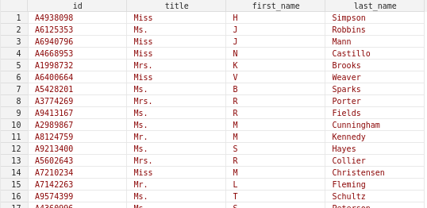
SELECT
s.id,
t.text as title,
s.first_name,
s.last_name
FROM
[students] AS s
INNER JOIN
[titles] AS t
ON
s.title_id = t.id

Slide 20
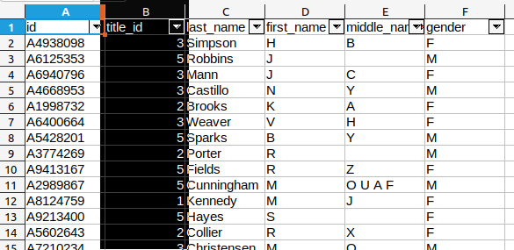
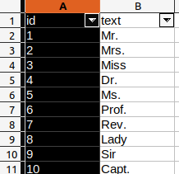
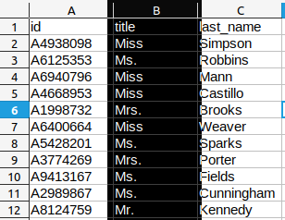
Spreadsheet analogy
Let's examine the example spreadsheet

Slide 21
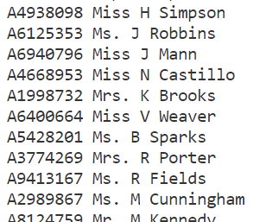
Python
# Connection set up, etc. omitted for brevity
query = '''
SELECT
s.id, t.text as title, s.first_name, s.last_name
FROM
[students] AS s
INNER JOIN
[titles] AS t
ON
s.title_id = t.id
'''
results = cursor.execute(query)
conn.commit()
for row in results:
print(row['id'], row['title’], row['first_name’], row['last_name'])

Slide 22
Students and their marks

Slide 23
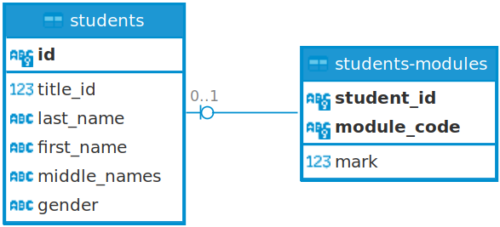
Student table; Student-Modules table
For the moment we'll ignore modules have names, etc.
The students-modules table keeps a record of all the modules that a students is enrolled on
It also is being used to record a mark for that module
student_id refers to a single student in the students table

Slide 24
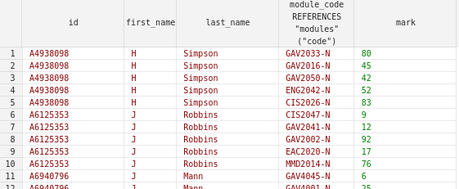
Get a student's marks
We need to JOIN the students and students-modules tables
SELECT
s.id,
s.first_name,
s.last_name,
sm.module_code,
sm.mark
FROM
[students] AS s
JOIN
[students-modules] AS sm
ON
s.id == sm.student_id
In this example, the FROM and JOIN tables could be swapped.
But what if we also want the module name and description? Where is that information and how do I get it?

Slide 25
Students, Modules, and Marks
Now we’re involving 3 tables

Slide 26
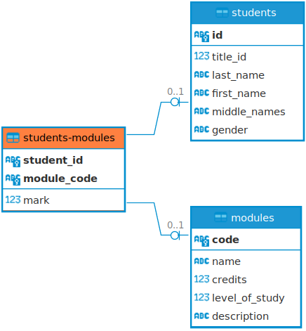
Students and Modules
modules table contains details about modules (Code, Description, credits, and so on…)
students table contains details about students (id, first name, last name, and so on…)
We link by a relation the two
We don’t want duplicates in either students or modules
We have a table that refers to both the student and their modules

Slide 27
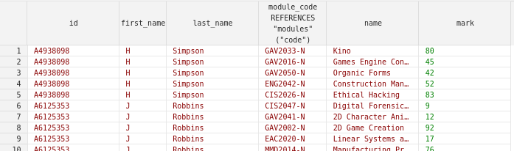
Answer
The module, description, etc is found in the modules table
If we want to include that information, we need to JOIN the modules table too
3 table JOIN
SELECT
s.id,
s.first_name,
s.last_name,
sm.module_code,
m.name,
sm.mark
FROM
[students] AS s
JOIN
[students-modules] AS sm
ON
s.id == sm.student_id
JOIN
[modules] AS m
ON
sm.module_code = m.code;

Slide 28
Student's mean average mark
How many ways...
(Fortunately, we don't need a 3 table JOIN for this...)

Slide 29
In Python... (data from SQL)
# Connection set up, and query etc. omitted for brevity
# Dictionary to hold all the student information
student_average_marks = {}
for row in results:
student_id = row['id']
if student_id not in student_average_marks.keys():
student_average_marks[student_id] = { "mark": 0, "module_count": 0 }
student_average_marks[student_id]['mark'] += row['mark']
student_average_marks[student_id]['module_count'] += 1
for id in student_average_marks.keys():
# Calculate the average
student_average_marks[id]['mark'] /= student_average_marks[id]['module_count']
print(f"{id} average mark: {student_average_marks[id]['mark']:.2f}")
average_mark_in_python.py
Full code on Blackboard

Slide 30
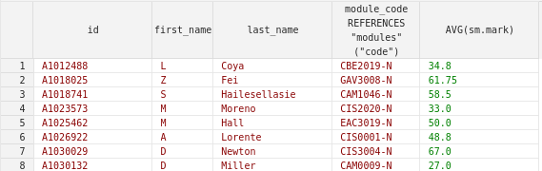
In SQL …
The SQL aggregate function AVG function is used to compute the average for all the matching rows for each student
This collapses all the rows for each student into a single row
However, we need to use GROUP BY to retain and orientate the data about a particular field, in this case the student id
If we didn't use GROUP BY then we'd end up with a single row
SELECT
s.id,
s.first_name,
s.last_name,
AVG(sm.mark)
FROM
[students] AS s
JOIN
[students-modules] AS sm
ON
s.id == sm.student_id
GROUP BY
s.id
Similar to the dictionary key in the Python example, we're organising the data returned by the student id

Slide 31
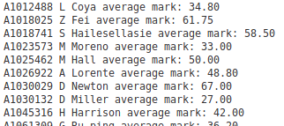
In Python and SQL
# Connection set up, and query etc. omitted for brevity
query = '''
SELECT
s.id, s.first_name, s.last_name,
AVG(sm.mark) AS average_mark
FROM
[students] AS s
JOIN
[students-modules] AS sm
ON
s.id == sm.student_id
GROUP BY
s.id
'''
results = cursor.execute(query)
conn.commit()
for row in results:
print(f"{row['id']} {row['first_name']} {row['last_name']} average mark: {row['average_mark']:.2f}")
average_mark_in_python_and sql.py
Full code on Blackboard

Slide 32
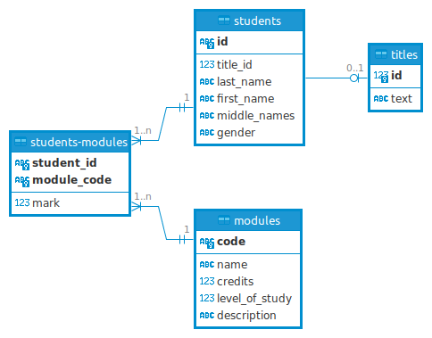
Full ERD
For information:
The ERD diagram was generated by DBeaver from the SQLite database

